Slide 1
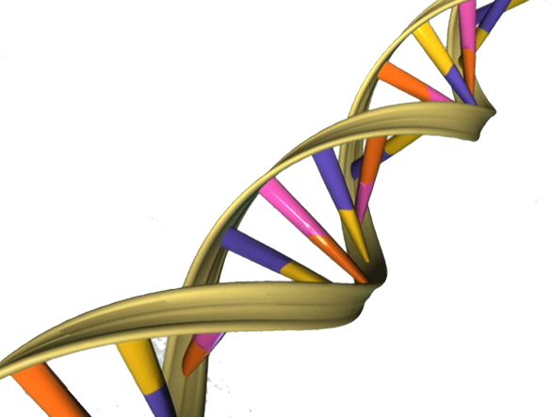
Imperial College London Presentation Template
Michael Crone
August 6, 2015
Michael Crone
Imperial College London :: Systems and Synthetic Biology

Slide 2
Contents
Michael Crone
Imperial College London :: Systems and Synthetic Biology

